Slide 1
Management skills

Slide 2

Three Key Factors of Great Companies
Mission Statements
Great Managers
Great Employees

Slide 3
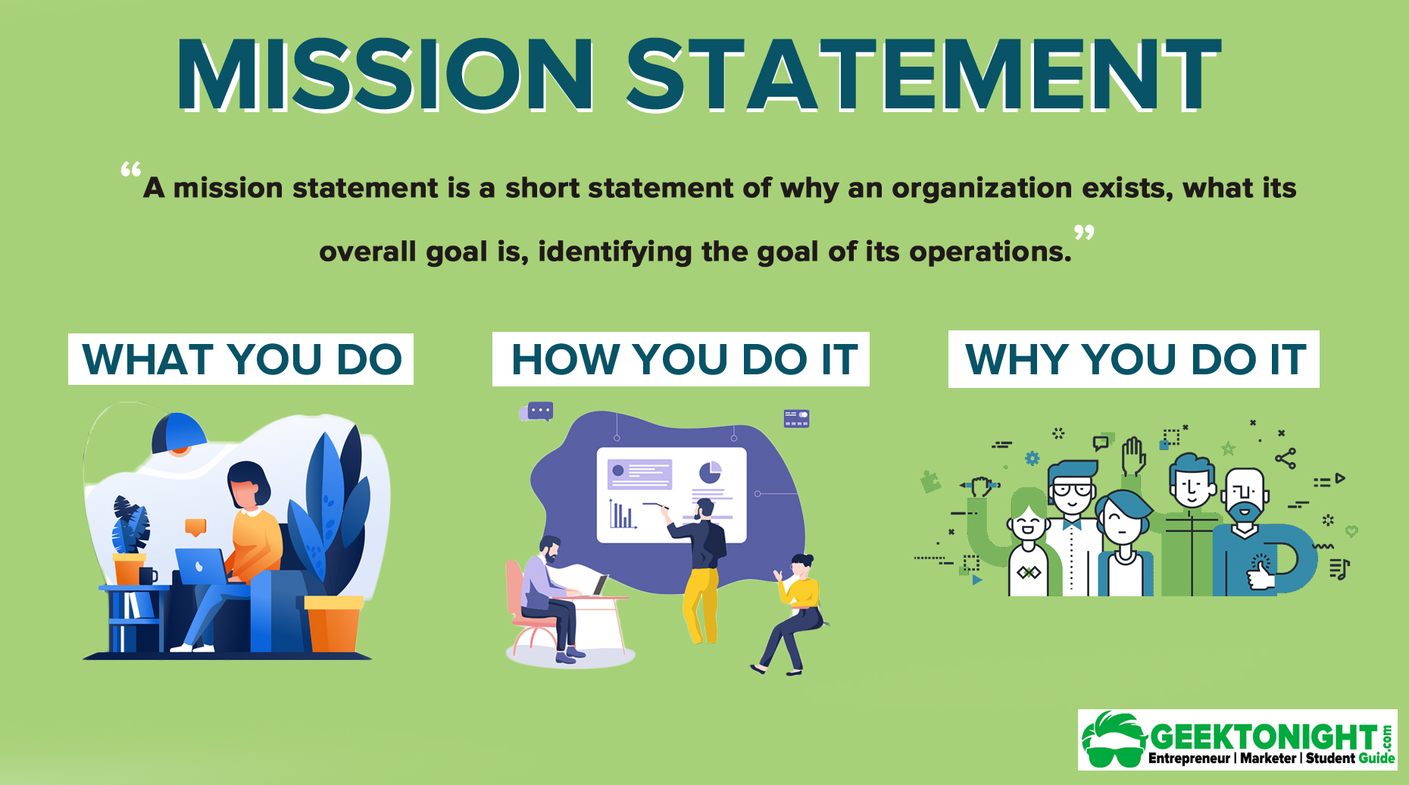
WHO YOU DO IT FOR

Slide 4



Mission Statement Answers:
What do we do?” — outline the main purpose of the organization
“How do we do it?” — how one plans on achieving the mission statement.
“Whom do we do it for?” — The audience of the mission statement should be clearly stated within the mission statement.
“Why - What value are we bringing?” — The benefits and values of the mission statement should be clearly outlined.

Slide 5


Tips for Writing a Mission Statement:
All Goals, Objectives, plans and functions of a business are geared toward meeting the mission statement
Should be expressed in just a paragraph or two
If you read it out loud, it should take about 30 seconds

Slide 6
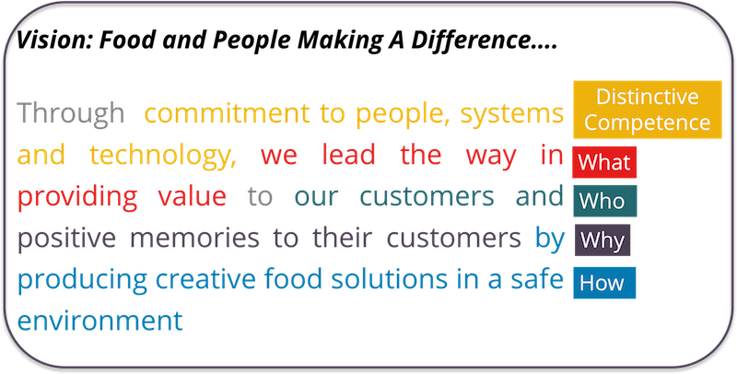

Mission Driven

Slide 7

Group Activity Are they doing it right!
Amazon: “To be Earth’s most customer-centric company, where customers can find and discover anything they might want to buy online, and endeavors to offer its customers the lowest possible prices.”
What
Who
Why
How:
Be a Customer-Centric Company (prioritizes the customer experience and needs in all business decisions)
Customers
Customers can find and discover anything they might want to buy
How: Offer anything Online at the lowest prices

Slide 8
Group Activity Are they doing it right!
Google: “To organize the world’s information and make it universally accessible and useful.”
What
Who
Why
How:
To Organize the Worlds Information
The World
Useful
Universally accessible

Slide 9
Group Activity Are they doing it right!
Walmart - “We save people money so they can live better.”
What
Who
Why
How:
Help people live better
People
Live Better
Save Money

Slide 10
Group Activity Are they doing it right!
Google: “To organize the world’s information and make it universally accessible and useful.”
Walmart - “We save people money so they can live better.”

Slide 11
Assignment Mission Statement
Go to Google Classroom, open the Google Docs to access the Business Mission Statement Assignment. Read and follow the instructions
Get two business numbers from Mrs. Vetter to complete this

